Slide 1
DIY Team Project
Device to Control Milk Spilling
By VNTP
Group Members:
Tanya Kumari (21CE10074),
Prathamesh Belavagi (21CE10014), Nikhil Atram (21AE10025),
Vedic Dutta (21CH10077)

Slide 2


Slide 3
Motivation Milk is one of the most important consumables used in daily life. While it is an essential for every household on a daily basis, it encounters many challenges to handle for processing. This is due to the composition of milk. Milk is made up of approximately 88% water, 5% lactose, 3% fat, 3 % protein, and 1% minerals.

Slide 4
The boiling temperature of milk is 100 C, which is same as that of water. While boiling milk filled to the brim, a thin layer of cream is present at the top. The water being lighter than the milk, rises up as water vapour, but is stopped by the layer. The layer does not break easily, and this may be attributed to the surface tension properties of the liquid.
Now, the building up of the pressure due to the water vapour trying to rise prompts the cream surface to rise to a point above the brim, beyond which the layer eventually breaks. This reveals a large amount of milk out, as the large size of the container’s mouth gives rise to a large volume of the milk spilling out despite the small height of the layer.

Slide 5
This leads to a wastage of this particularly precious fluid. Available Methods: a) Using solid object such as spatula over the container b) Putting water in the container c) Applying butter on the container’s inner neck.

Slide 6
Summary:
Milk is an important everyday commodity, but can be lost to spilling off utensils if left unattended.
Traditional methods available for the same problem mostly contain challenges of their own.
Most of the methods also require monitoring by the user.
Our work address this problem effectively without any of the said challenges!

Slide 7
Parts: A) Electronic (electric circuit):

Slide 8
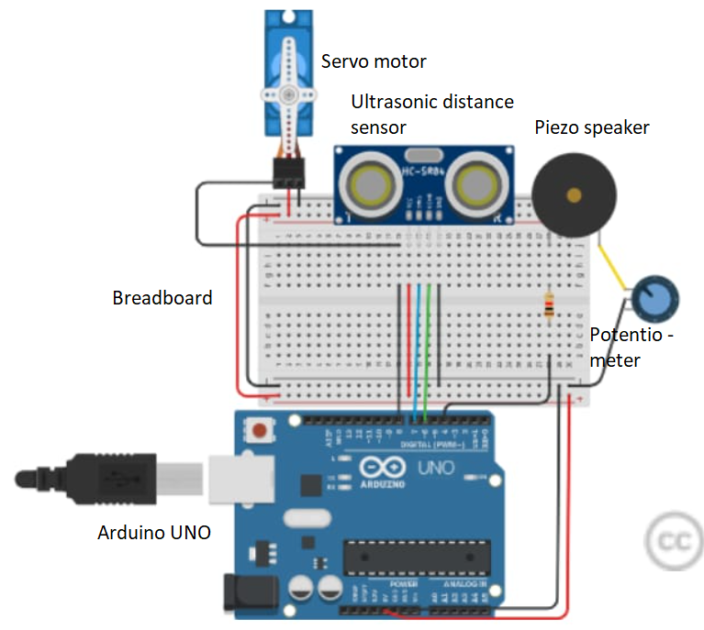

Slide 9
Parts: B) Mechanical (moulded in plastic):

Slide 10
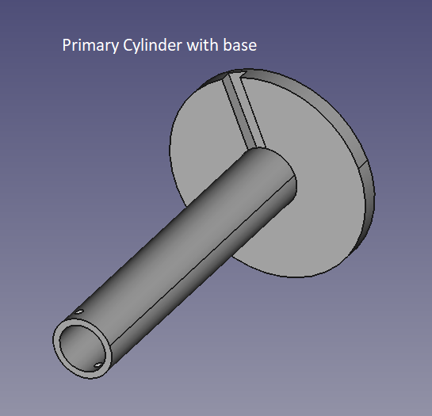
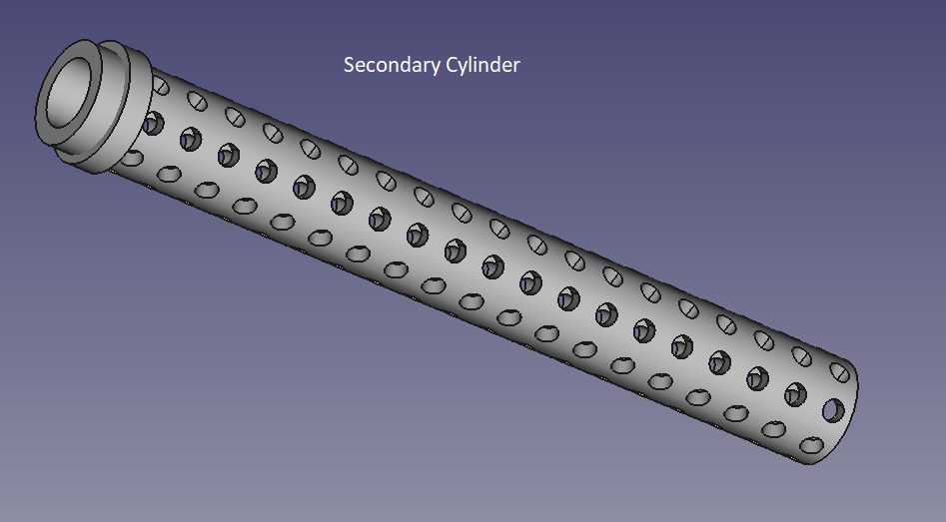
Dimensions: 9mm (outer radius), 7mm (inner radius), 100mm (height),
Base: 30mm(radius), groove of 9mm width
It holds the whole structure straight, and the screw passes through it first.
Dimensions: 6mm (outer radius), 4mm (inner radius), 100mm (height),
It holds the sensor casing, and the holes allow the user to adjust height at small intervals of distance, for great accuracy.

Slide 11
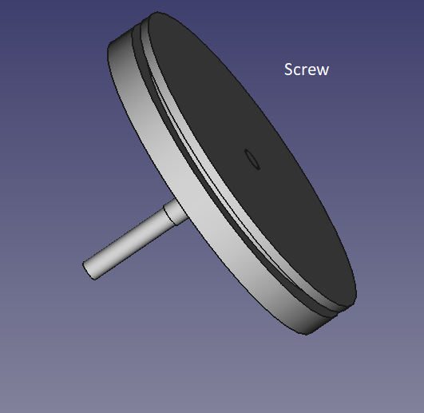
Dimensions: 10mm (arm),
Base: 17.5 mm(radius),
It keeps the height of the two cylinders fixed, by passing through the two cylinders through the screw holes. The arm’s length has been adjusted so that it passes through both sides.

Slide 12
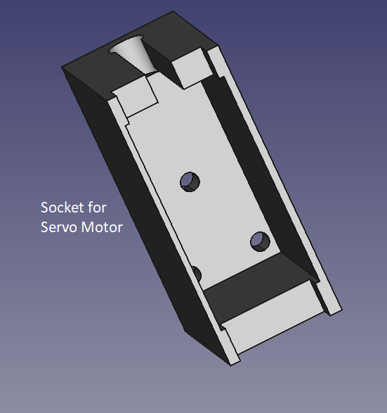
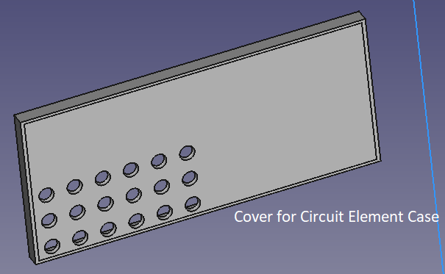
Dimensions: same as standard micro-servo motor (28mm x 17mm x 3mm)
It is fixed to the stove through the holes provided for screws, and it holds the servo motor at place.
Dimensions: front face same as the case for circuit elements (180mm x 80mm), with height being 8mm.
It acts as a protective covering for the circuit elements case.

Slide 13
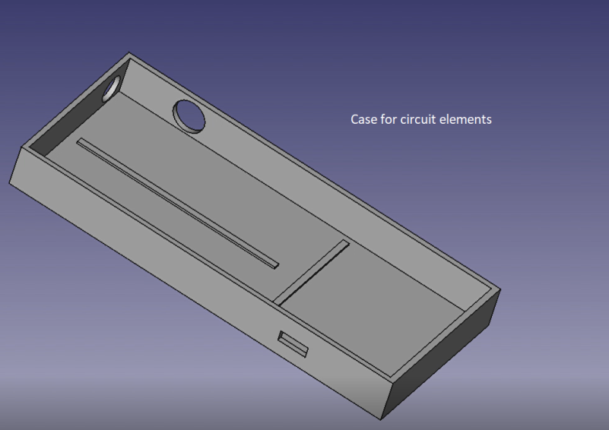
Dimensions: 180mm (length), 80mm (breadth), 20mm (height).
It has separate positions for the Arduino, Breadboard and Speaker to stay. It also has holes to withdraw cables from the same. It is the central control system in the whole device.

Slide 14
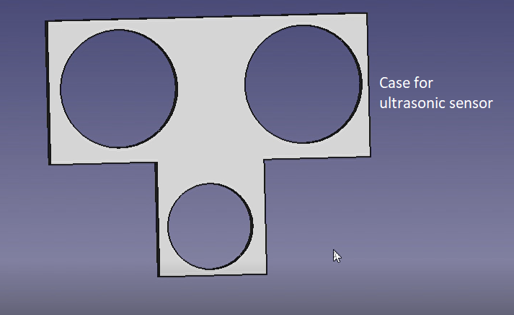
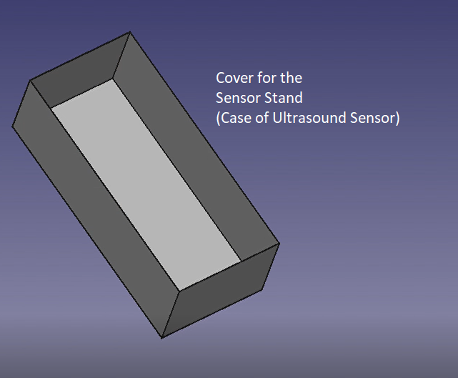
Dimensions:
Length of the larger section: 45.1mm
Radius of the two holes: 8.25 mm
The two holes are separated from each other by 26mm.
It holds the sensor over the utensil.
Dimensions:
(Same as the larger section of the case above)
It covers the case above from the top.

Slide 15
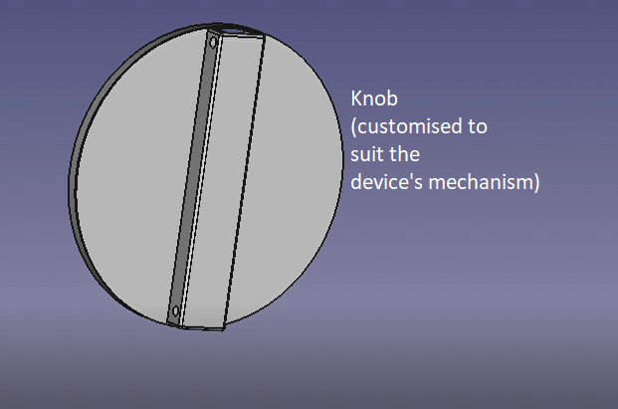
Dimensions: 60.1mm(diameter)
It is fixed to the top of the usual knob, and contains holes to attach to the chord. It moves in correspondence with the motor.

Slide 16
Summary

Slide 18
Working principle:
The inner cylinder remains partially inside the outer cylinder, and the screw holds it fixed at the adjusted height position.
In normal conditions, the knob, and the motor, have a particular specified state, corresponding the gas being on. As the milk rises to a certain height, which would normally ensue spilling, the sensor sends a signal to the Arduino UNO, which then sends a signal to the motor to rotate clockwise. This leads to switching off of the gas supply.
Simultaneously, a signal is sent to the speaker as well, which alerts the user that the milk has reached the spilling point, so that the user can take subsequent action as appropriate. This eliminates the need of monitoring on the part of the user for the whole time.

Slide 19
However, there might arise be a problem. If the user is not able to reach the point at the appropriate time, the gas may leak again, owing to the turning of the sensor now in the anticlockwise direction.
This problem is resolved by the use of cords, as is explained problem.

Slide 20
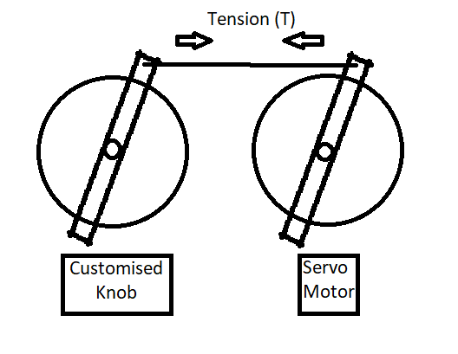
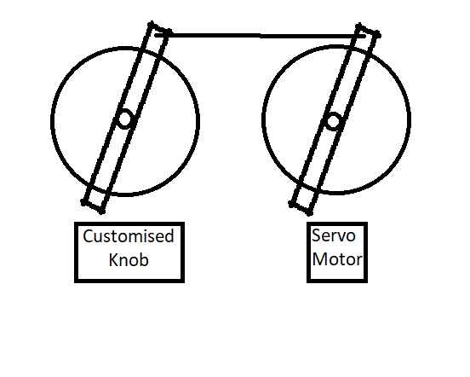
The problem of gas leakage resolved:
Once both the bars become horizontal, the gas stops, and the milk starts to go down.
Thus, the distance increases, triggering a signal which prompts the motor to rotate anticlockwise again to reach the initial state where the gas was on, and the milk was yet to reach the brim.
Under such circumstances, one might expect that the under rigid conditions, the knob moves correspondingly, so the gas starts up once again.

Slide 21
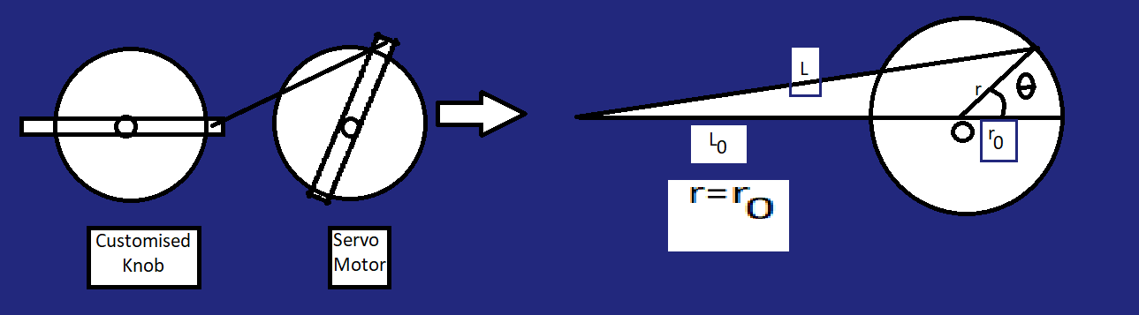
However, we exploit the property of a string here, which is, tension in a slack string is 0.
The use of this property to solve our problem can be shown mathematically.
Let us think of all the lengths in terms of vectors. Then, by law of vector addition, we get
L=L0+r0 => |L|=|L0+r| <= |L0|+|r0| = initial length (using triangle inequality, and the fact that |r|=|r0|.)

Slide 22
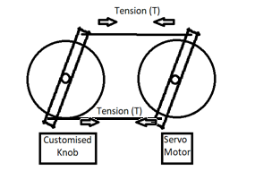
The equality holds only for horizontal position of both bars. Thus, in any other condition, the string becomes slack, thus preventing the subsequent motion of the knob.
In case the motion of the knob is desired, a second string is attached to the other side of the knob and the motor arm.

Slide 23
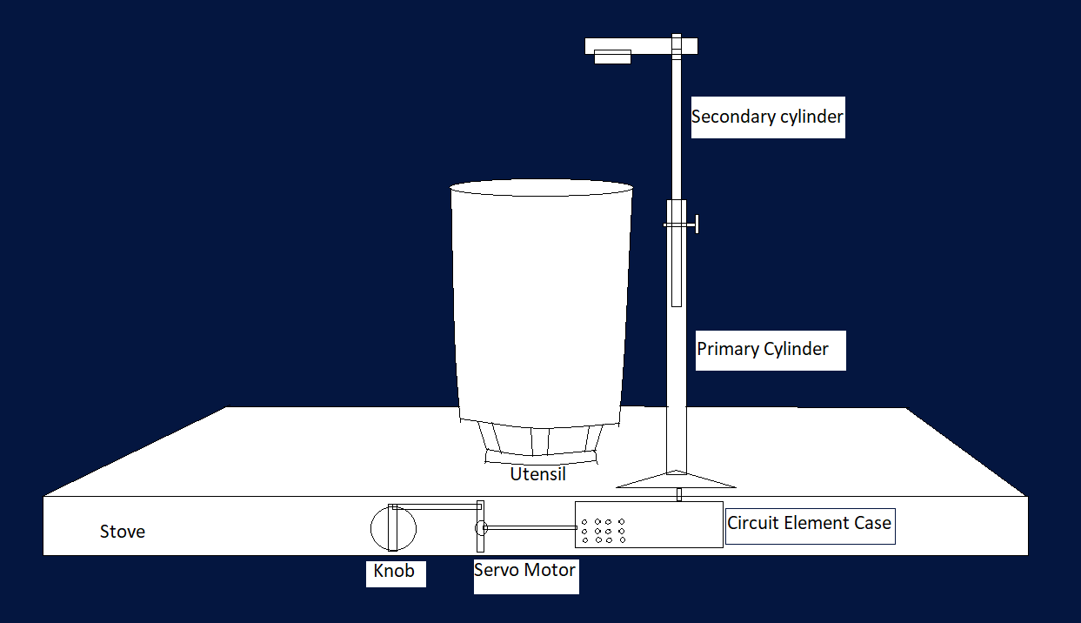
A Schematic:
(Figure not to scale)

Slide 24
Parts needed for the project:
Sl. No. | Part Name | Quantity required | Description | Technical specifications | Approximate cost (in rupees)
1 | Arduino Uno | 1 | Central circuit board to store the logic | R3 | 400
2 | Breadboard | 1 | Board with interconnected ports | Small | 60
3 | Piezo Speaker | 1 | Produces sound depending on signal | 20mm | 50
4 | Servo motor | 1 | Rotates arm depending on the signal | Micro | 100
5 | Wires | 10 | For connection between the various circuit components | 20cm | 20
6 | Cord | 1 | To attach motor arm with the knob | Nylon, Thin | 20
7 | Ultrasound Distance Sensor | 1 | To measure the level of milk | HC-SR04 | 60
8 | 3D printed parts as specified above |  | To support the whole circuit, and act as mechanical parts

Slide 25
Software to be used in the project: 1) FreeCAD: It is an open source software to build models for 3D printing. It has a handy interface, and is user friendly. The FreeCAD software will be used to build the mechanical parts of the project. The version used is 0.19. 2) TinkerCad: It is a free website used to simulate circuits. It has a codeblocks feature, which makes it very easy to use. It will be used to make the circuit board.

Slide 26
Work sharing: 1) Circuit parts design (TinkerCad): Prathamesh Belavagi, Tanya Kumari 2) Mechanical parts design (FreeCAD): Nikhil Atram, Vedic Dutta.

Slide 27
Thank you

